Slide 1
Wireless Device Securities

Slide 2
Wireless Device Securities
The approach that was taken was to implement a layered model to enhance the security procedures, the ability to separate each layer gave engineers the opportunity to investigate and mitigate fragilities of the movements of packets whether that be through the Ethernet or wireless.
Easier to teach communication process.
Speeds development, changes in one layer does not affect how the other levels works.
Standardization across manufactures.
Allows different hardware and software to work together.
Reduces complexity.
The process the IEEE put in place was the OSI model.

Slide 3
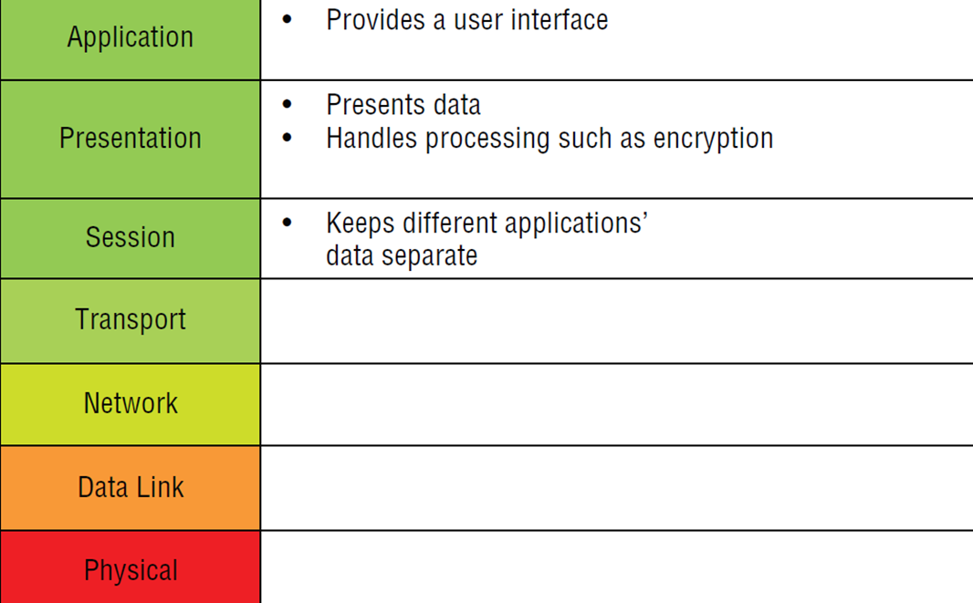
Wireless Device Securities
Open System Interconnection Model(OSI) Upper Layers
The link layer is subdivided into two sub-layers: MAC (Medium Access Control) and LLC (Logical Link Control). LLC is defined in a separate standard 802.2 for all types of local networks. Its protocol manages the connection between sending and receiving computers.

Slide 4
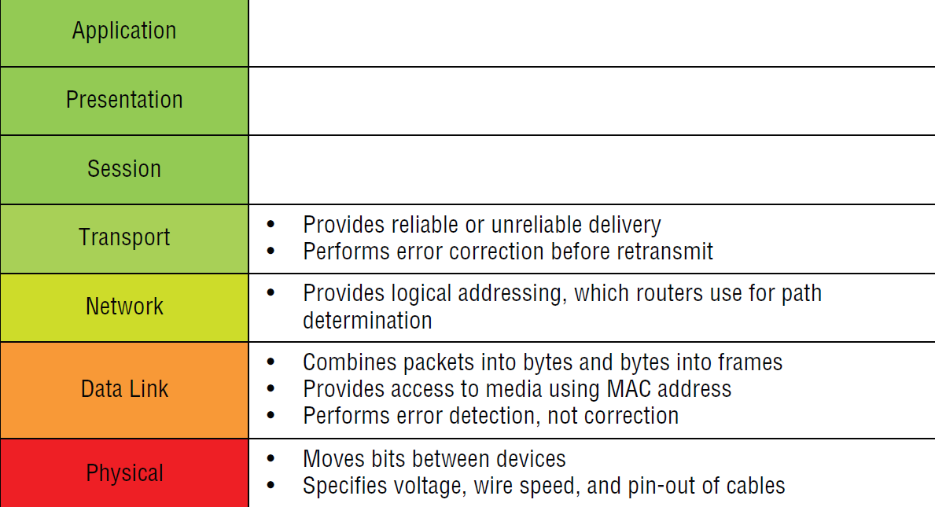
Wireless Device Securities
Open System Interconnection Model(OSI) Lower Layers
MAC ensures data packaging into so called MAC protocol data units (MPDU)and controls access to the carrier medium and the mode of operation, which has been defined in the physical layer.
The appropriate rules come into play, when several stations share the same carrier medium. The purpose of the MAC protocols is to avoid collisions and in consequence data loss. This could happen, if several stations within the same network try to send and receive data at the same time.

Slide 5
Wireless Device Securities
Wireless devices that can be vulnerable to attack can include;
WLAN
Mobile Phones
Bluetooth
Infrared
Near Field Communication

Slide 6
Wireless Device Securities
WEP
Wireless encryption uses security standards which started with the Wired Equivalent Privacy (WEP) standard.
This encryption method was introduced in 1999 as part of the 802.11b standard to provide secure wireless communications using the RC4 stream cipher system from RSA. WEP uses a symmetric encryption scheme where a shared key is used for both encryption and
decryption.
It was, however, quickly breached and anyone intercepting and monitoring the wireless traffic could easily break the encryption using a brute force attack with tools such as Airsnort and WEPCrack.
WEP is inadequate for protecting wireless networks and that organisations should deploy stronger encryption protocols such as Temporal Key Integrity Protocol (TKIP)

Slide 7
Wireless Device Securities
Wi-Fi Protected Access(WPA)
A solution had to be found to improve the securities of the flawed WEP structure. Although WEP worked fine if there were no hackers, increased security was needed to protect WiFi systems.
A new scheme was developed under the control of the WiFi alliance, amendments were made to the IEEE 802.11i standard the key difference was the use of Temporal Key Integrity Protocol, creating a more rigorous security that could perform packet key mixing.
This enhanced the encryption method used in the previous weak WEP.

Slide 8
Wireless Device Securities
Wi-Fi Protected Access2(WPA2)
The WPA2 scheme for Wi-Fi network security has now superseded the basic WPA or WPAv1 scheme. WPA2 implements the mandatory elements of IEEE 802.11i. In particular, it introduces Cipher-block Chaining Message (CCMP), a new AES-based encryption mode with strong security.
Certification for WPA2 began in September, 2004 and now it is mandatory for all new devices that bear the Wi-Fi trademark.
Advance Encryption Standard(AES) uses a 128bit key to encrypt data in 128 blocks. The 128 data blocks can use cypher keys of 128, 192 and 256 bits.

Slide 9
Wireless Device Securities
Wireless networks receive more attention due to the deficiency of physical hurdles but wired equivalent also has breaches in its defences.
A wireless access point will always be controlled by its wired equivalent, even large WiFi masts will still be connected to a physical area.
Both sections must be equally secured to prevent any kind of malicious attacks.
Mitigating a breach of data loss during transmission is what the security administrator endeavours for in modern day systems.

Slide 10
Wireless Device Securities
IEEE 802.3
Physical Security:
Port control and access prevention
Secured ports to assigned MAC addresses
Physical security of all network hardware, routers, switches, servers etc….
Perform an auditing map( understand what hardware is running at what time. Should it be running at that time?
Controlled patch and software updates
Personnel access control

Slide 11
Wireless Device Securities
IEEE 802.11 Wireless Security
Piggybacking. If you fail to secure your wireless network, anyone with a wireless-enabled computer in range of your access point can use your connection
Wardriving
Evil Twin Attacks
Wireless Sniffing. ...
Unauthorized Computer Access. ...
Shoulder Surfing. ...
Theft of Mobile Devices.

Slide 12
Wireless Device Securities
Wardriving
Driving around an area with a laptop computer and an 802.11 wireless LAN adapter in order to find unsecured wireless LANs. When the laptop's wireless network adapter (NIC) is set to promiscuous mode, it will receive any packets within its range. GPS systems can be added to get the geo location of each access point.
The goal is to find vulnerable sites either to obtain free Internet service or to potentially gain illegal access to the organization's data.

Slide 13
Wireless Device Securities
Evil Twin Attacks
This layer 2 attack on wireless systems still persists today even though attacks have been witnessed for over 20 years, mitigating these problems are difficult to solve. The problem lies in the hardware of the systems such as mobile phones and laptops, they re not equipped to distinguish between two radio signals broadcasting at the same time with the same SSID name.
This allows for a Man in the Middle attack to extract sensitive information without leaving traces behind them.

Slide 14
Wireless Device Securities
IDS/IPS
Intrusion Detection Systems (IDSs) and Intrusion Prevention Systems (IPSs) are very important in today’s networks. They are network security appliances that monitor networks and packets for malicious activity. An IDS is considered monitor mode and just records and tells you about problems, whereas an IPS can work in real time to stop threats as they occur.
The main difference between them is that an IPS works inline to actively prevent and block intrusions that are detected based on the rules you set up. IPSs can send an alarm, create correlation rules and remediation, drop malicious packets, provide malware protection, and reset the connection of offending source hosts.

Slide 15
Wireless Device Securities
Intrusion Detection Systems (IDSs)
An IDS is not a firewall! Firewalls are designed to be outward looking and to limit access between networks in order to prevent an intrusion happening. IDS watch the wired and wireless network from the inside and report or alarm depending on how they evaluate the network traffic they see.
They continually monitor for access points to the network and are able, in some cases, to do comparisons of the security controls defined on the access point with pre-defined company security standards and either reset or closedown any non conforming AP’s they find.
In their simplest form, Intrusion detection systems are designed and built to monitor and report on network activities, or packets, between communicating devices.

Slide 16
Wireless Device Securities
Intrusion Prevention Systems (IPSs)
Like IDS the Intrusion Prevention System enhances security difference is that as well
as well as observing events and informing security administrators of important actions.
IPS can respond to situations that is detected and start prevention responses .
IPS can stop the attack from damaging the network and system attached.
Comparison of IPS with IDS
Intrusion prevention systems are placed in-line and are able to actively prevent or block intrusions that are detected.
IPS can take such actions as sending an alarm, dropping detected malicious packets, resetting a connection or blocking traffic from the offending IP address.
IPS also can correct cyclic redundancy check (CRC) errors, defragment packet streams, mitigate TCP sequencing issues and clean up unwanted transport and network layer options.

Slide 17
Vistumbler
Vistumbler is an open source Windows application that finds Wireless access points - Uses the Vista command 'netsh wlan show networks mode=bssid' to get wireless information. It displays the basic AP details, including the exact authentication and encryption methods, and can even speak the SSID and RSSI.
It also displays graphs of signal levels. It's highly customizable and offers flexible configuration options. It supports AP names to help distinguish them, also helping to detect rogue APs.

Slide 18
Vistumbler
Find Wireless access points - Uses the Vista command 'netsh wlan show networks mode=bssid' to get wireless information
GPS Support
Export/Import access points from Vistumbler TXT/VS1/VSZ or Netstumbler TXT/Text NS1
Export access point GPS locations to a google earth kml file or GPX(GPS eXchange format)
Live Google Earth Tracking - Auto KML automatically shows access points in google earth.
Speaks Signal Strength using sound files, windows sound api, or MIDI
Open Source (GPLv2 License / Written in AutoIt Scripting Language)

Slide 19
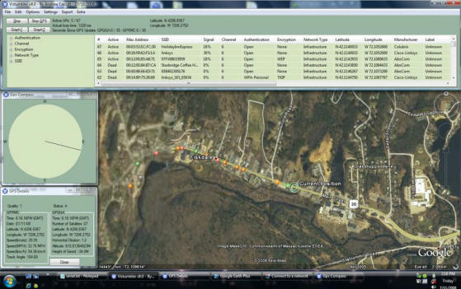
Vistumbler
Vistumbler is wireless network scanner written in Auto IT for Windows . The main purpose of Vistumbler is to map and visualize the access points around you based on the wireless and GPS data collected.

Slide 20
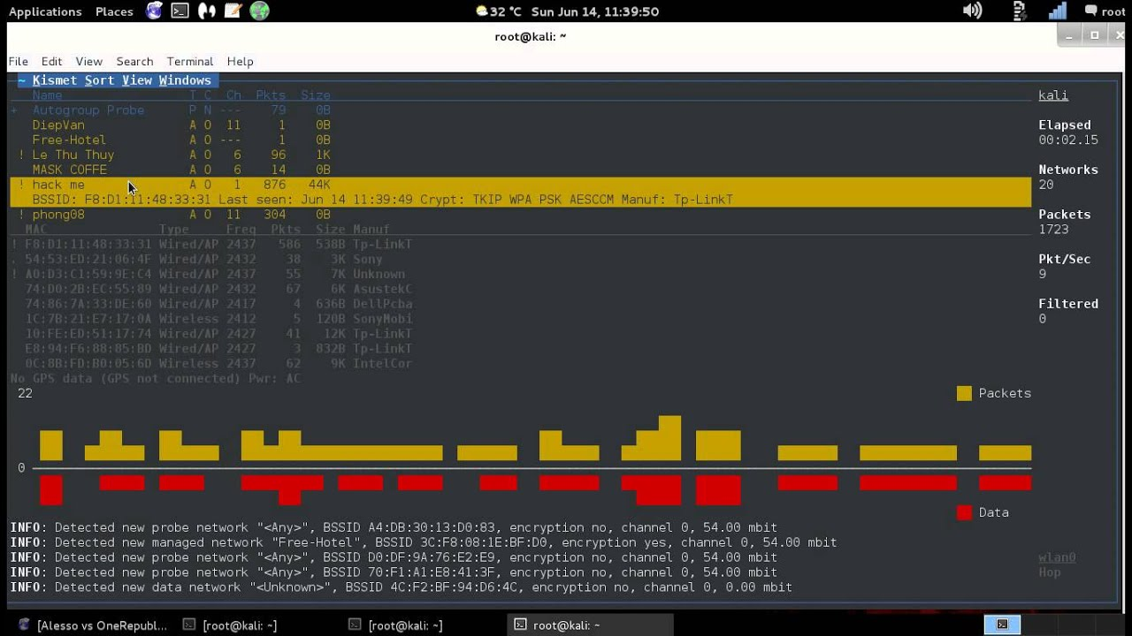
Kismet IDS

Slide 21
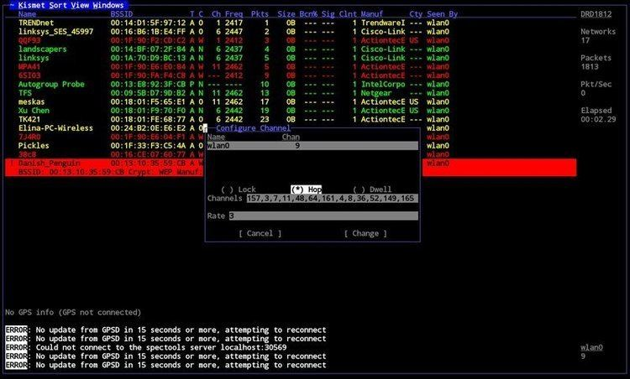
Kismet IDS
Kismet is a network detector, packet sniffer, and intrusion detection system for 802.11 wireless LANs. Kismet will work with any wireless card which supports raw monitoring mode, and can sniff 802.11a, 802.11b, 802.11g, and 802.11n traffic.

